Slide 1
Discussion 1 - Control, Environment Diagrams
Chris Allsman
Section 120

Slide 2
Functions Review
print(print(“one”) and 2)

Slide 3
Agenda
Administrivia
Review of Functions & Control
Attendance
Environment Diagram Rules!

Slide 4
Administrivia
HW1 due tonight
Lab 0 + Lab 1 due Friday
Hog out!
Phase 1 due 2/5 (Work individually)
Whole project due 2/7 (Can work in partners for phase 2/3)
Fill out links.cs61a.org/chris-intro if you didn’t complete the form last week

Slide 5
Stuff from Disc0
Lot of common fears re: keeping up with content and feeling inadequate
Know that you aren’t alone here!
Questions about lecture?
Time at beginning, or ask at links.cs61a.org/chris-questions
Extra resources?
My OH are 6:30-8:00 Tuesday, 241 Cory but email if you want to meet 1-1
CSM small-group tutoring, CS 3701 1-1 tutoring, etc. starting soon

Slide 6
Boolean Stuff in Python
False-y
False
0
None
“ ”, [ ], { }
Truth-y
True
1
-1
“Hello”
Almost everything else

Slide 7
Logic
And
Evaluates to first false-y or last truth-y value (and stops evaluating there)
“Are you free Saturday and Sunday?”
Or
Evaluates to first truth-y or last false-y value (and stops evaluating there)
“Are you free Saturday or Sunday?”

Slide 8
Functions Review
print(print(“one”) and 2)

Slide 9
Functions Review
print(print(“one”) and 2)
1) Evaluate Operator

Slide 10
Functions Review
print(print(“one”) and 2)
2) Evaluate Operands

Slide 11
Functions Review
print(print(“one”) and 2)
Evaluate L -> R

Slide 12
Functions Review
print(print(“one”) and 2)
Output:
one
Print removes outer quotation marks

Slide 13
Functions Review
print(print(“one”) and 2)
Evaluates to None
Output:
one

Slide 14
Functions Review
print(None and 2)
Output:
one

Slide 15
Functions Review
print(None and 2)
Evaluates to None (short circuits)
Output:
one

Slide 16
Functions Review
print(None)
3) Apply operator to operand
Output:
one

Slide 17
Functions Review
print(None)
3) Apply operator to operand
Output:
one
None

Slide 18
Control Review
n = 0
if n < 10:
print(1)
elif n >= 0:
print(2)

Slide 19
Control Review
n = 0
if n < 10:
print(1)
elif n >= 0:
print(2)

Slide 20
Control Review
n = 0
if n < 10:
print(1)
if n >= 0:
print(2)

Slide 21
Control Review
n = 0
if n < 10:
print(1)
if n >= 0:
print(2)

Slide 22
Control Review
n = 100
if n < 10:
print(1)
print(2)

Slide 23
Control Review
n = 100
if n < 10:
print(1)
print(2)

Slide 24
Control Review
n = 100
if n == 100:
print(1)
print(2)

Slide 25
Iteration
while <cond>:
<body>
Keep evaluating body until <cond> is false-y
Should make sure it’s eventually false!

Slide 26
Summary
False Values: True Values:
False, 0, None, Everything
[ ], “ ”, { } else
if <cond>:
...
elif <cond>:
...
else:
...
Any number of these
Optional
And: evaluates to first false or last true value
Or: evaluates to first true or last false value
while <cond>:
...
Keep evaluating body until False-y

Slide 27
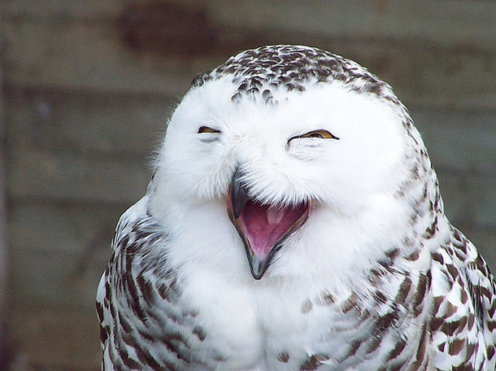
Attendance!
links.cs61a.org/chris-disc
Magic Word: mustard

Slide 28

Environment Diagrams

Slide 29
Frames
An object that lists bindings between names + values
Also tells us how to look bindings up
Global Frame exists by default
Other frames created when we call functions

Slide 30
A (quick) aside:
Expression evaluate to values
1 + 1 → 2
These values can be present in bindings
Statements don’t evaluate to values
e.g. def statements, assignment statements
So wouldn’t do return x = 2
Can still change our environment

Slide 31

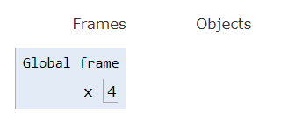
Assignment Statements
Creates a new binding in your current frame!

Slide 32
Assignments:
Evaluate RHS
Make binding in current frame

Slide 33
Def Statements
Also create bindings!
Name of binding is name of the function
Value is name + parameters + parent
A function value
Parent of a function = where it’s defined
Note: function values are objects that are pointed to

Slide 34
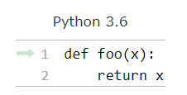
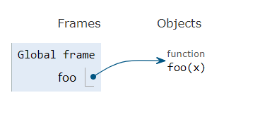
Def Statements
[P = G]

Slide 35
Assignment Statements:
Evaluate RHS
Make binding in current frame
Def Statements:
[P = G]
Don’t go into body yet
Make binding in current frame

Slide 36
Call Expressions
Follow the golden rules of evaluation:
Evaluate operator
Evaluate operands
Apply operator to operands
Call expressions create new frames!

Slide 37
Creating frames
Give frame a unique label (f1, f2, f3)
Label the frame with the function’s intrinsic name (the name from the def statement) if it exists
Label it with the parent (defined earlier)

Slide 38
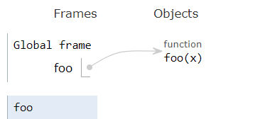
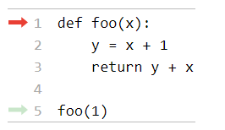
Example:
f1
[P = G]

Slide 39
Call Expressions
After creating frame:
Bind parameters to arguments (what you pass in)
Evaluate body using the earlier rules
At end, be sure to put the return value (by default, None)

Slide 40
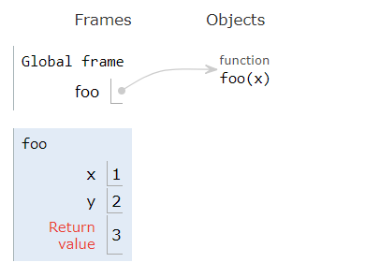
Example:
[P = G]
f1

Slide 41
Assignment Statements:
Call Expressions:
Evaluate RHS
Make binding in current frame
Def Statements:
[P = G]
Label w/ index, name, parent
f1
[P = G]
[P = G]
Bind arguments to parameters
Don’t go into body yet
Make binding in current frame
Return something

Slide 42
Lookups
When trying to find the value of a variable:
If it’s in your current frame, great!
If not, look in the parent of your frame, then in your parent’s parent, and so on
If there are no more parents (you’re in the global frame), it doesn’t exist!

Slide 43
Links!
links.cs61a.org/chris-feedback
links.cs61a.org/chris-intro
links.cs61a.org/chris-questions
links.cs61a.org/chris-disc

